Slide 1
Hive
Imp concepts

Slide 2
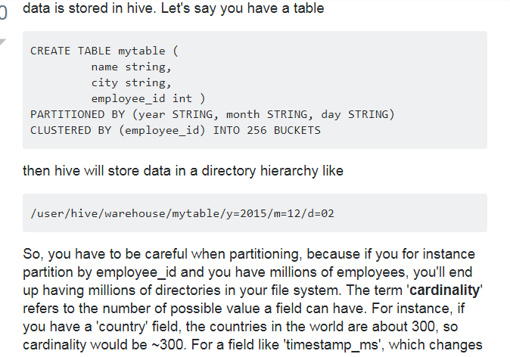
What is Partitions?
Partitioning data is often used for distributing load horizontally, this has performance benefit, and helps in organizing data in a logical fashion.
Hive Partitions is a way to organizes tables into partitions by dividing tables into different parts based on partition keys.

Slide 3
every millisecond, cardinality can be billions. In general, when choosing a field for partitioning, it should not have a high cardinality, because you'll end up with way too many directories in your file system.
Clustering aka bucketing on the other hand, will result with a fixed number of files, since you do specify the number of buckets. What hive will do is to take the field, calculate a hash and assign a record to that bucket. But what happens if you use let's say 256 buckets and the field you're bucketing on has a low cardinality (for instance, it's a US state, so can be only 50 different values) ? You'll have 50 buckets with data, and 206 buckets with no data.
Someone already mentioned how partitions can dramatically cut the amount of data you're querying. So in my example table, if you want to query only from a certain date forward, the partitioning by year/month/day is going to dramatically cut the amount of IO. I think that somebody also mentioned how bucketing can speed up joins with other tables that have exactly the same bucketing, so in my example, if you're joining two tables on the same employee_id, hive can do the join bucket by bucket (even better if they're already sorted by employee_id since it's going to mergesort parts that are already sorted, which works in linear time aka O(n) ).
So, bucketing works well when the field has high cardinality and data is evenly distributed among buckets. Partitioning works best when the cardinality of the partitioning field is not too high.
Also, you can partition on multiple fields, with an order (year/month/day is a good example), while you can bucket on only one field.

Slide 4
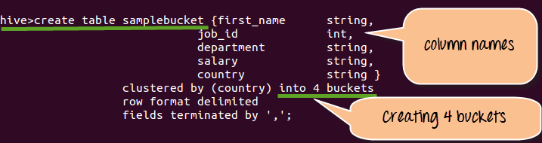
Buckets in hive is used in segregating of hive table-data into multiple files or directories. it is used for efficient querying.
The data i.e. present in that partitions can be divided further into Buckets
The division is performed based on Hash of particular columns that we selected in the table.
Buckets use some form of Hashing algorithm at back end to read each record and place it into buckets
In Hive, we have to enable buckets by using the set.hive.enforce.bucketing=true;
Step 1) Creating Bucket as shown below.
Step 2) Loading Data into table sample bucket

Slide 5
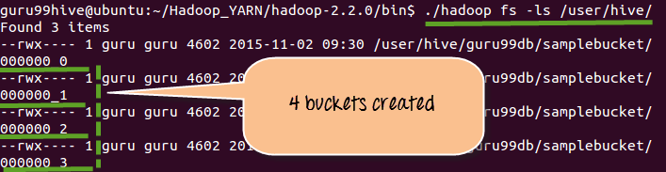
Displaying 4 buckets that created in Step 1

Slide 6
Pros:
Distribute execution load horizontally
Faster execution of queries in case of partition with low volume of data. e.g. Get the population from "Vatican city" returns very fast instead of searching entire population of world.
Cons:
Possibility of too many small partition creations - too many directories.
Effective for low volume data for a given partition. But some queries like group by on high volume of data still take long time to execute. e.g. Grouping of population of China will take long time compared to grouping of population in Vatican city. Partition is not solving responsiveness problem in case of data skewing towards a particular partition value.
Hive Bucketing:
Bucketing decomposes data into more manageable or equal parts.
With partitioning, there is a possibility that you can create multiple small partitions based on column values. If you go for bucketing, you are restricting number of buckets to store the data. This number is defined during table creation scripts.
Pros
Due to equal volumes of data in each partition, joins at Map side will be quicker.
Faster query response like partitioning
Cons
You can define number of buckets during table creation but loading of equal volume of data has to be done manually by programmers.

Slide 7
understanding partitioning & Bucketing
1. create a table schema lets say employee
internal
create table employee(name String,city string,empid int,year string,month string,day string);
or external
create external table employee(name String,city string,empid int,year string,month string,day string);
Location '/user/neha/external table';
2. load data into that table from a text file
Load data inpath '/user/neha/data.txt' into table employee;
3. cretae a different table schema which u want to partition & or bucketized
create table emp_par_buck (name string,city string,empid string)
partitioned by (year string,month string,day string)
clustered by (empid) into 256 buckets;
4. load the data in part/bucketized table from the source table
insert overwrite into table emp_par_buck partition(year string,month string,day string) select * from employee;
Note :--watch the columns carefully in case of partitioning.
for bucketing set hive.enforce.bucketing= true;
fr partitioning set hive.exec.dynamic.partition.mode=nonstrict

Slide 8
Partitioning Extra example
For Example: -
"Client having Some E –commerce data which belongs to India operations in which each state (38 states) operations mentioned in as a whole. If we take state column as partition key and perform partitions on that India data as a whole, we can able to get Number of partitions (38 partitions) which is equal to number of states (38) present in India. Such that each state data can be viewed separately in partitions tables.
Sample Code Snippet for partitions
1. Creation of Table all states
create table all states(state string, District string,Enrolments string) row format delimited fields terminated by ',';
Loading data into created table all states
Load data local inpath '/home/hduser/Desktop/AllStates.csv' into table allstates;
Creation of partition table
create table state_part(District string,Enrolments string) PARTITIONED BY(state string);
For partition we have to set this property
set hive.exec.dynamic.partition.mode=nonstrict
Loading data into partition table
INSERT OVERWRITE TABLE state_part PARTITION(state) SELECT district,enrolments,state from allstates;

Slide 9
. What is dynamic partitioning and when is it used?
In dynamic partitioning values for partition columns are known in the runtime, i.e. It is known during loading of the data into a Hive table.
One may use dynamic partition in following two cases:
Loading data from an existing non-partitioned table to improve the sampling and therefore, decrease the query latency.
When one does not know all the values of the partitions before hand and therefore, finding these partition values manually from a huge data sets is a tedious task.
Enable dynamic partitioning in Hive:
SET hive.exec.dynamic.partition = true;
SET hive.exec.dynamic.partition.mode = nonstrict;

Slide 10
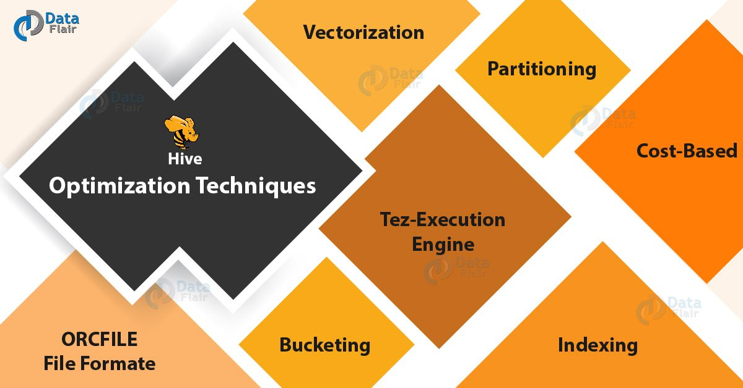
Hive optimatisation Techniques
Following are the Hive optimization techniques for Hive Performance Tuning, let’s discuss them one by one:

Slide 11
Tez Execution Engine – Hive Optimization Techniques, to increase the Hive performance of our hive query by using our execution engine as Tez. On defining Tez, it is a new application framework built on Hadoop Yarn. That executes complex-directed acyclic graphs of general data processing tasks. However, we can consider it to be a much more flexible and powerful successor to the map-reduce framework.
ORCFILE File Formate – Hive Optimization Techniques, if we use appropriate file format on the basis of data. It will drastically increase our query performance. Basically, for increasing your query performance ORC file format is best suitable. Here, ORC refers to Optimized Row Columnar. That implies we can store data in an optimized way than the other file formats.
To be more specific, ORC reduces the size of the original data up to 75%. Hence, data processing speed also increases. On comparing to Text, Sequence and RC file formats, ORC shows better performance. Basically, it contains rows data in groups. Such as Stripes along with a file footer. Therefore, we can say when Hive is processing the data ORC format improves the performance.
c. Hive Partitioning
d. Bucketing in Hive

